Slide 1
Audio Texture Way Find
TAMU Diversity Accessibility Hackathon

Slide 3
Our Challenge-
Improve navigational accessibility for visually impaired students around campus.

Slide 4
Our Solution-
Using new physical Construct a mixed tech and physical framework to assist users to more easily navigate new and changing spaces around campus

Slide 5
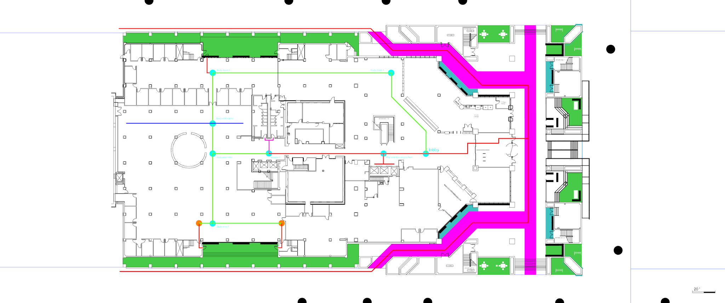

Slide 6
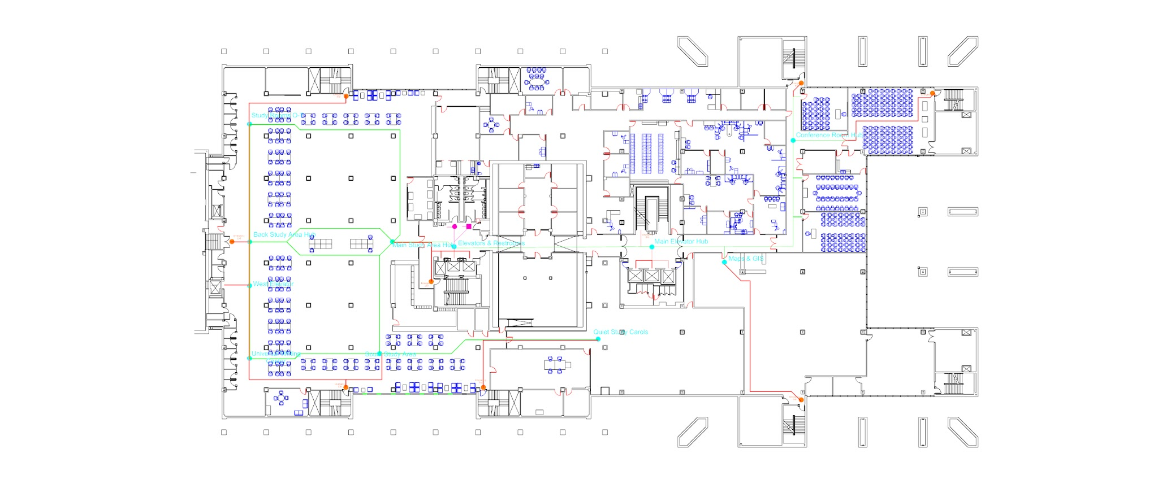
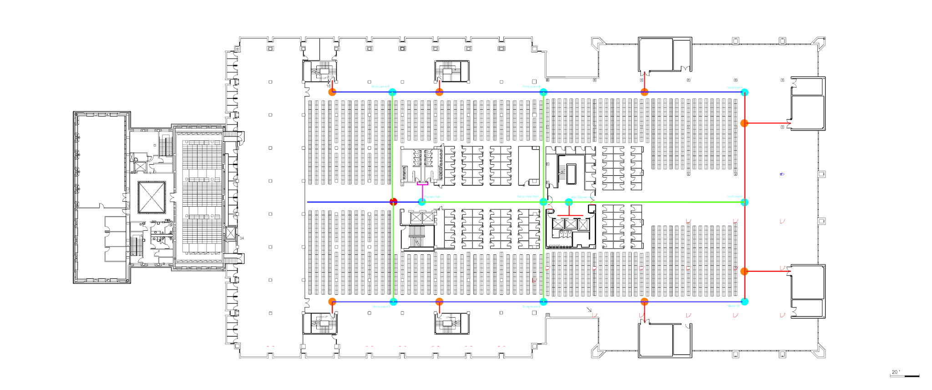
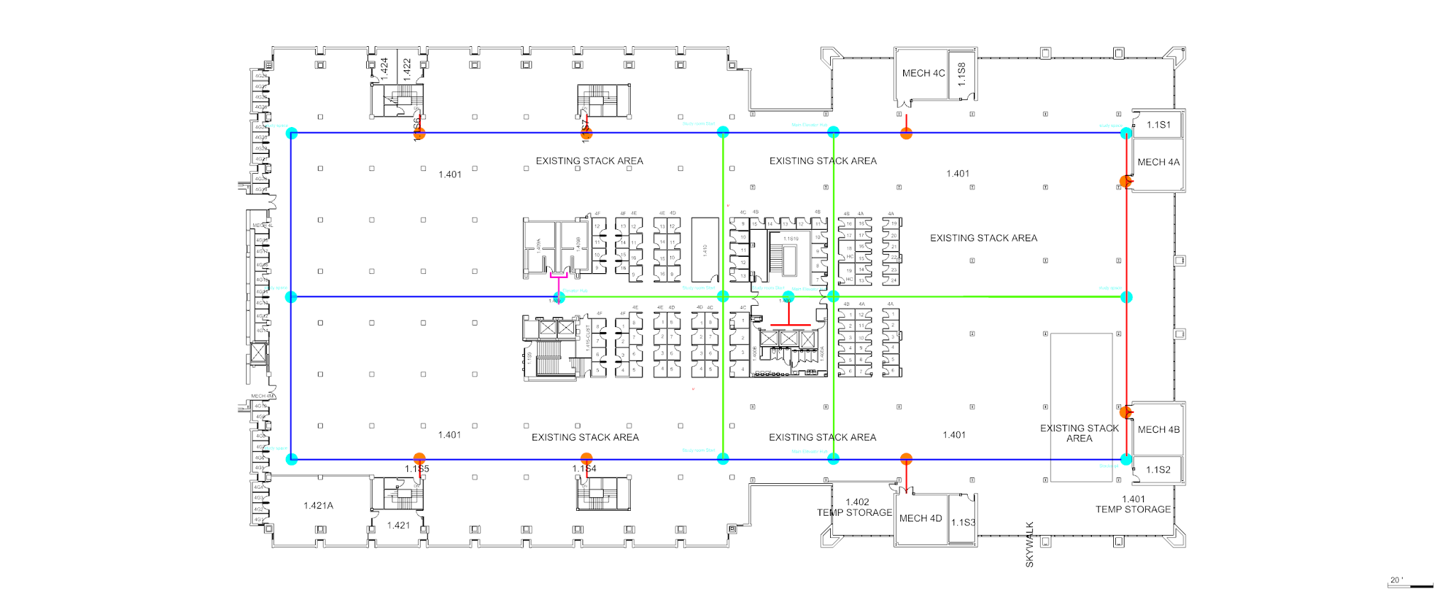

Slide 7
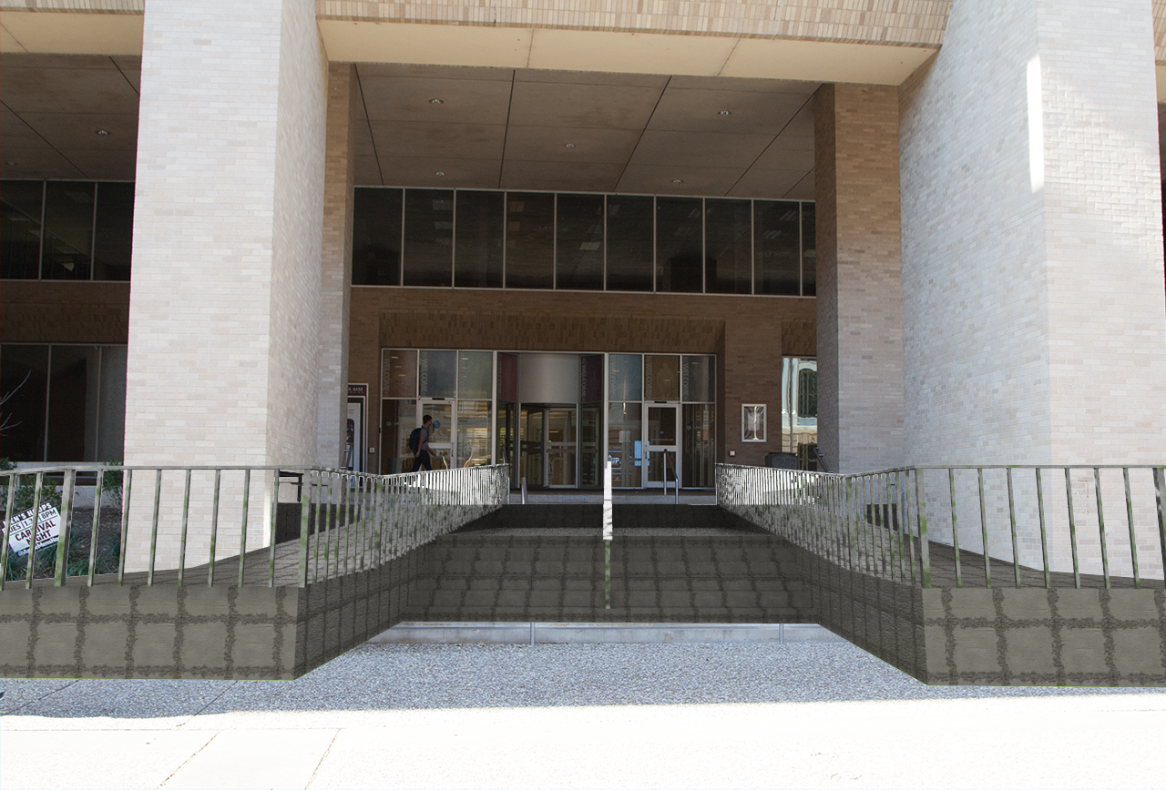

Slide 8

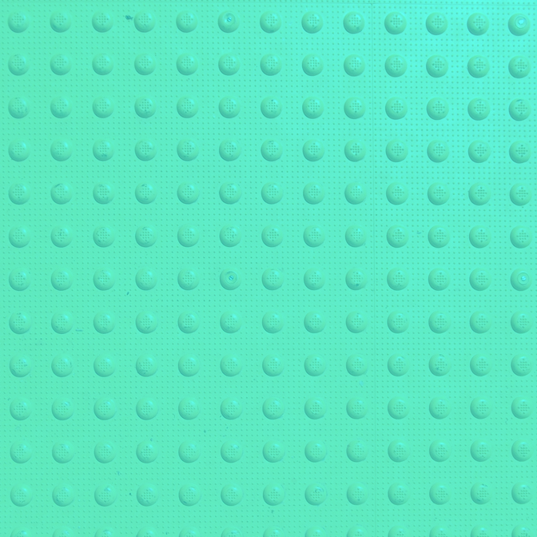
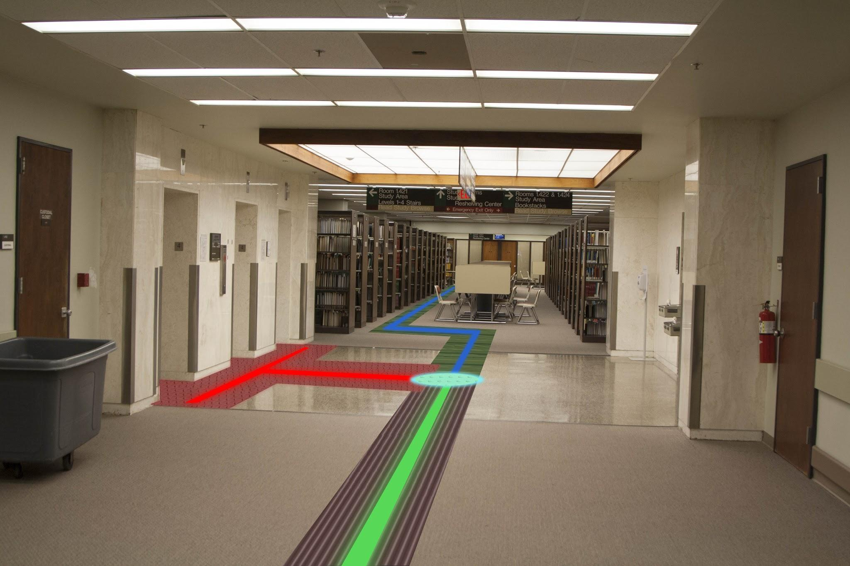
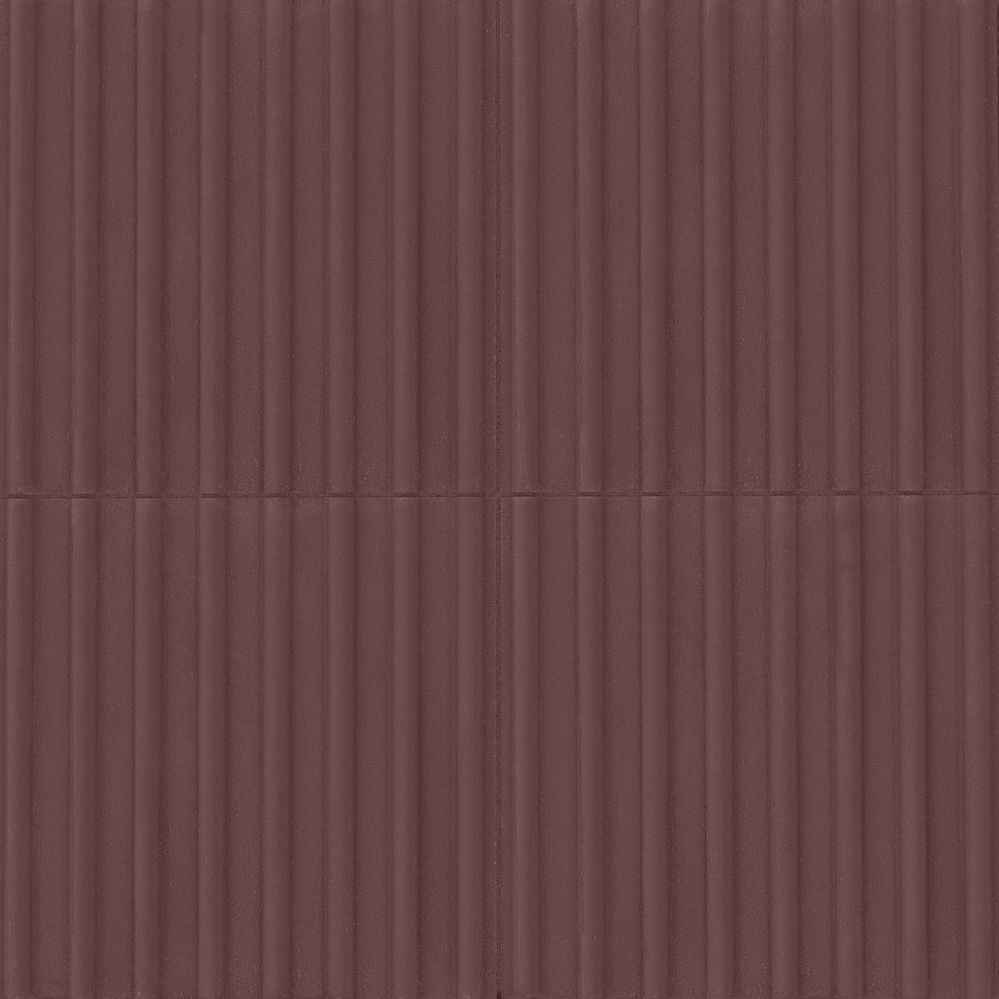
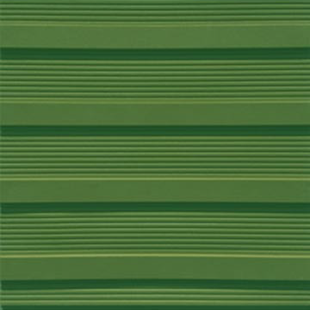
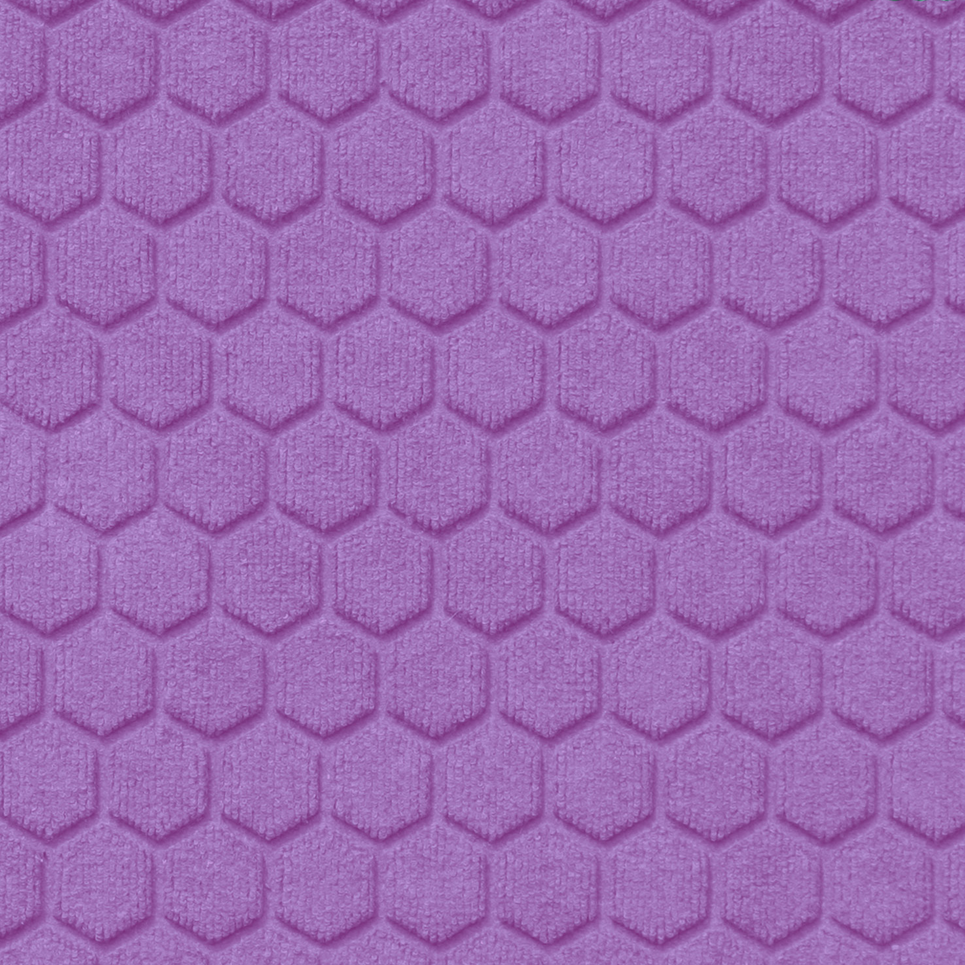
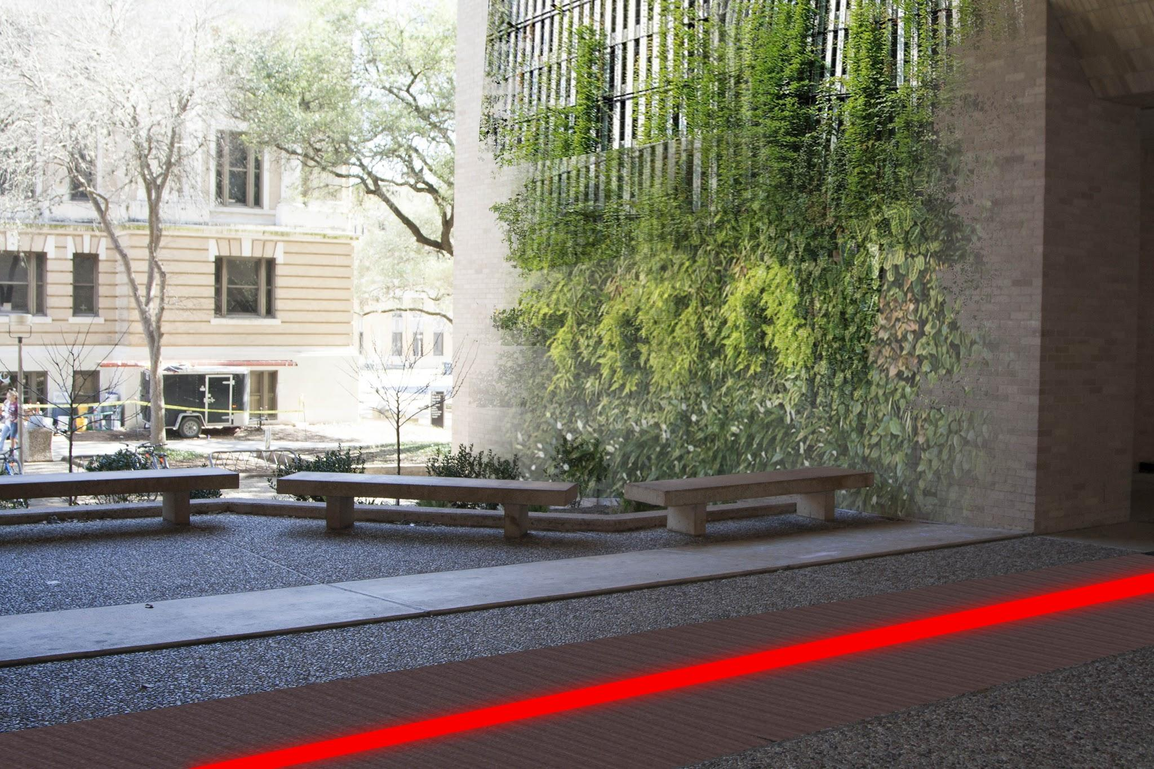
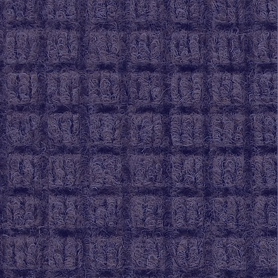

Materials
Texture Patterns

Slide 9
Benefits
The new system can be used without fear of getting lost, granting a greater confidence to students who may otherwise be unwilling to go.
Schools willing to implement this will give greater opportunity to students with disabilities.

Slide 10
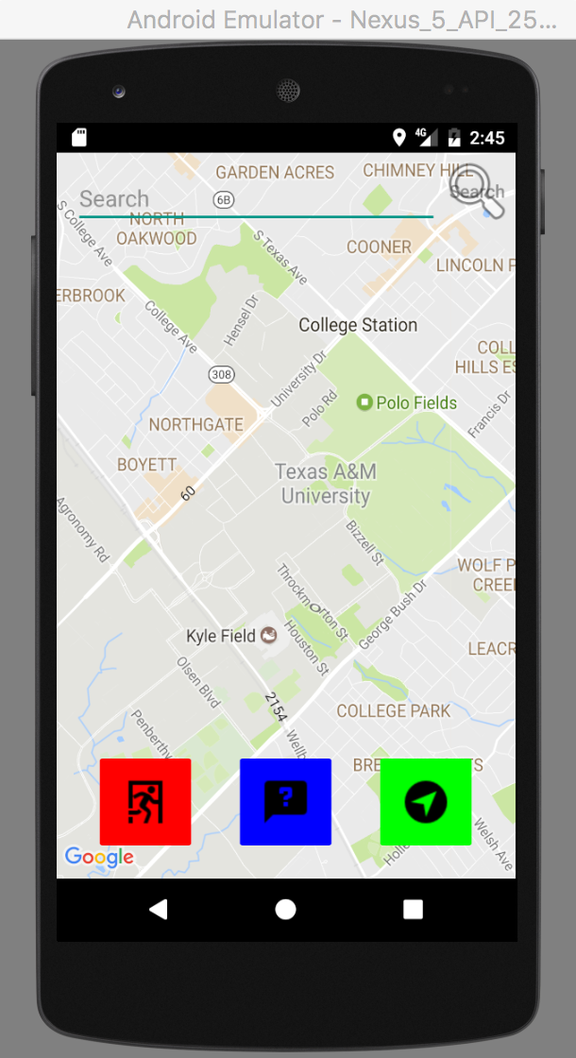
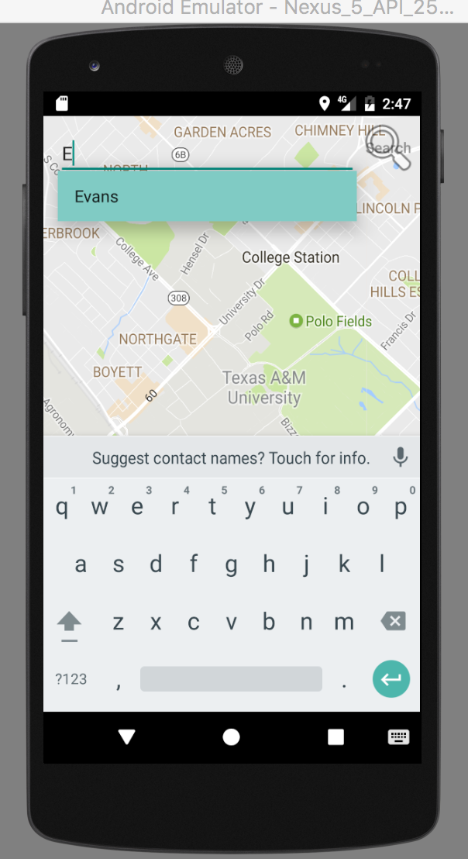
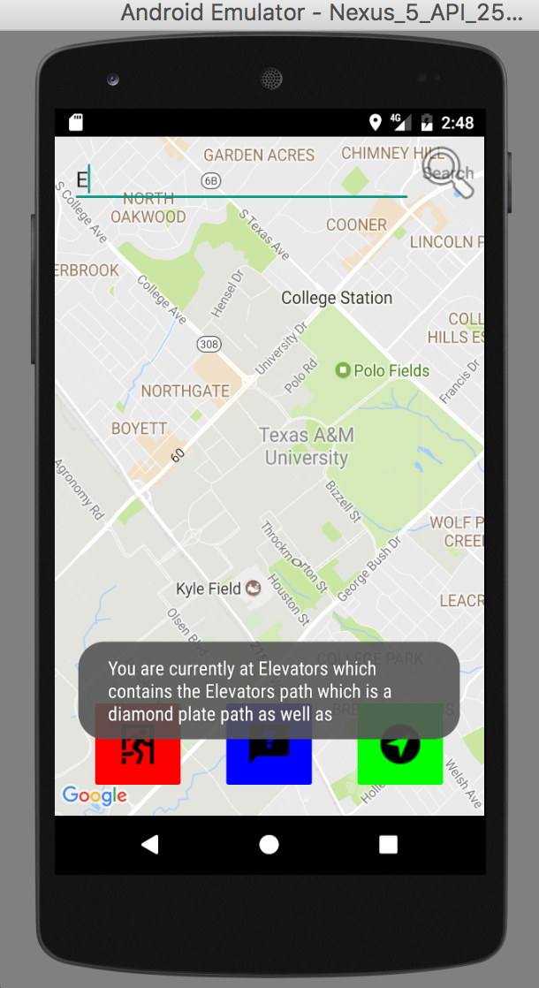
What We Made
Notes:
Given a 24 hour period onl

Slide 11
Interdisciplinary Collaboration
Computer Science (College of Engineering), Computer Engineering (College of Engineering), Technology Management (College of Education), Architecture (College of Architecture)
A combination of of our fields in Architecture and Technology has allowed us to produce something greater than we could have created individually. The application calls for a physical change to the layout of the building to improve accommodations for the blind and visually impaired.

Slide 12
Where Can We Go With This?
Navigation to exist in emergency situations
Include building across Texas A&M
Add to a database of objects, obstacles, and paths
Increased location tracking
Can be used in the workplace to give employers more incentive to hire.

